Slide 1



Human Pose Estimation
Giacomo Virginio & Mikhail Kolobov
Università degli Studi di Padova
February, 2024

Slide 2

Introduction
Human pose estimation is a critical challenge in computer vision, aiming to determine the configuration of a person's body parts from images or videos. This technology has vast applications, from enhancing interactive gaming experiences to advancing surveillance systems. Our report delves into optimizing pose estimation models, specifically on the Leeds Sports Pose dataset, drawing inspiration from Xiao et al.'s foundational work. We explore various model architectures to strike a balance between computational efficiency and accuracy, pushing the boundaries of what's achievable in this dynamic field.

Slide 3
Dataset
Leeds Sports Pose dataset - is a benchmark for evaluating human pose estimation models, focusing on sports activities.
Composition: Contains images of individuals in various athletic poses, providing a diverse range of body movements and configurations (2000 images with 14 key points each).
Annotations: Each image is meticulously annotated with key body joint locations, facilitating detailed pose analysis.
Use Case: Ideal for testing the effectiveness of pose estimation algorithms in recognizing and predicting complex human poses in sports scenarios.

Slide 4
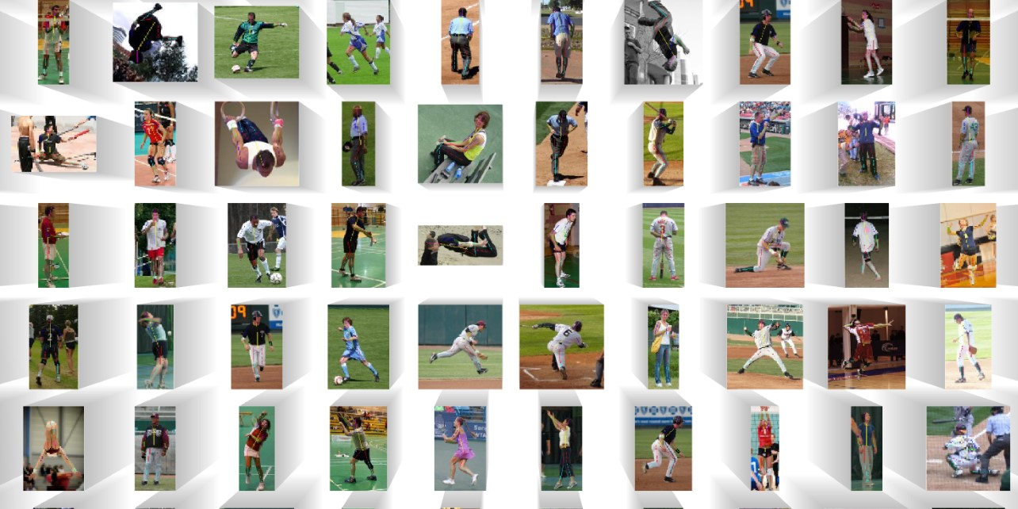

Slide 5
Method
Our methodology for improving human pose estimation on the LSP dataset builds upon the framework established by Xiao et al. We focus on adapting and enhancing baseline models, specifically employing pretrained architectures such as ResNet, EfficientNet, and ShuffleNet, tailored for computational efficiency. Key to our approach is the balance between model complexity and performance, aiming to refine accuracy under computational constraints. This involves trying multiple adjustments to model architectures and the training process, exploring the potential of lightweight models in capturing detailed human poses.

Slide 6
Modifications
Backbone Adaptation: Unlike Xiao et al., who built their model's structure before applying pretrained weights, we utilized pretrained models directly as the backbone. This "plug-and-play" approach facilitated the exploration of various architectures but limited our ability to leverage low-level features for enhancements such as the WASP module.
Heatmap Modification for Loss Function: We encountered issues with the original method's heatmap affecting model learning. Initially, the model minimized loss by reducing heatmap values to zero. To address this, we modified the Gaussian distribution parameters in the ground truth heatmaps, enhancing the model's ability to learn joint positions more effectively and without the excessive overfitting observed with the original parameters.

Slide 7
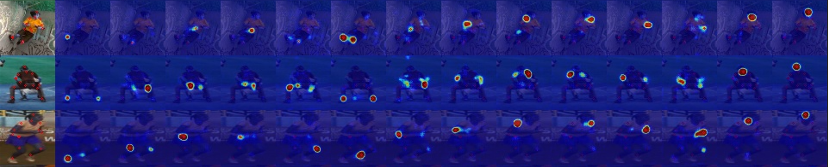
Example of the heatmaps

Slide 8
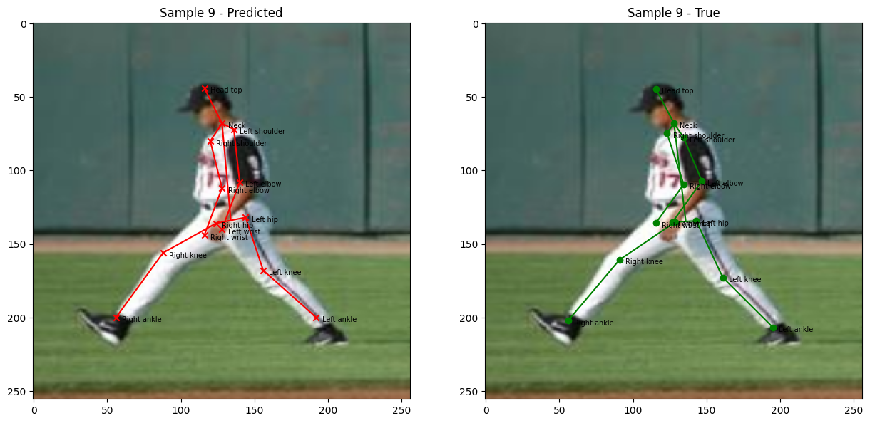
Example of predictions

Slide 9
Experiments
Baseline Model Slide: Our baseline model employs a ResNet50 backbone, modified to operate on 256x256 images, leading to 64x64 output heatmaps. It includes three deconvolution layers with 256 filters each and a final convolution layer, trained while unfreezing only the last few layers. This setup provides a balance between detail capture and computational efficiency, serving as a foundation for comparing the impact of architectural adjustments.

Slide 10
Models tested
Base (ResNet50 with modifications)
Kernel_Size 3
Final_Kernel_Size_1
Image_Size_128x128
2_Deconvolution_Layers
Freeze_All_Layers
ResNet18
EfficientNet_V2_S
ShuffleNet_V2_x2_0 (two versions)

Slide 11
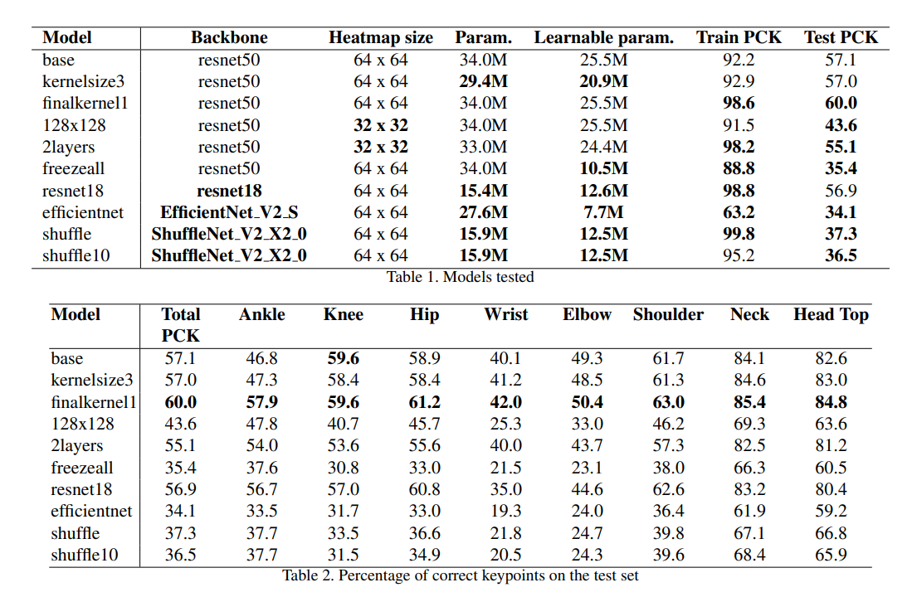

Slide 12
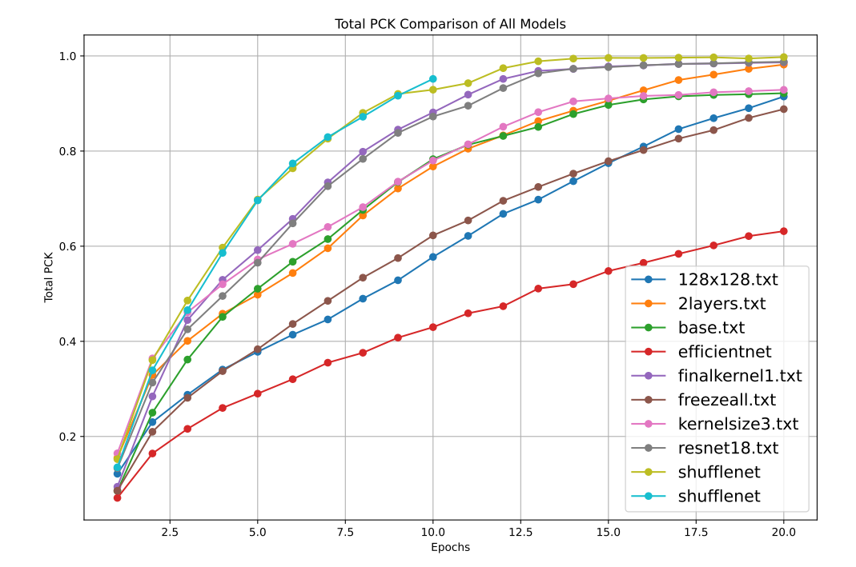

Slide 13
Conclusion
The experiments highlight the delicate balance between model architecture, training strategy, and computational resources in human pose estimation. Our findings suggest that modifications, such as using a ResNet18 backbone, adjusting kernel sizes, and optimizing layer configurations, can significantly enhance model performance within computational constraints. These insights pave the way for future research aimed at refining efficiency and accuracy in pose estimation.

